Slide 1
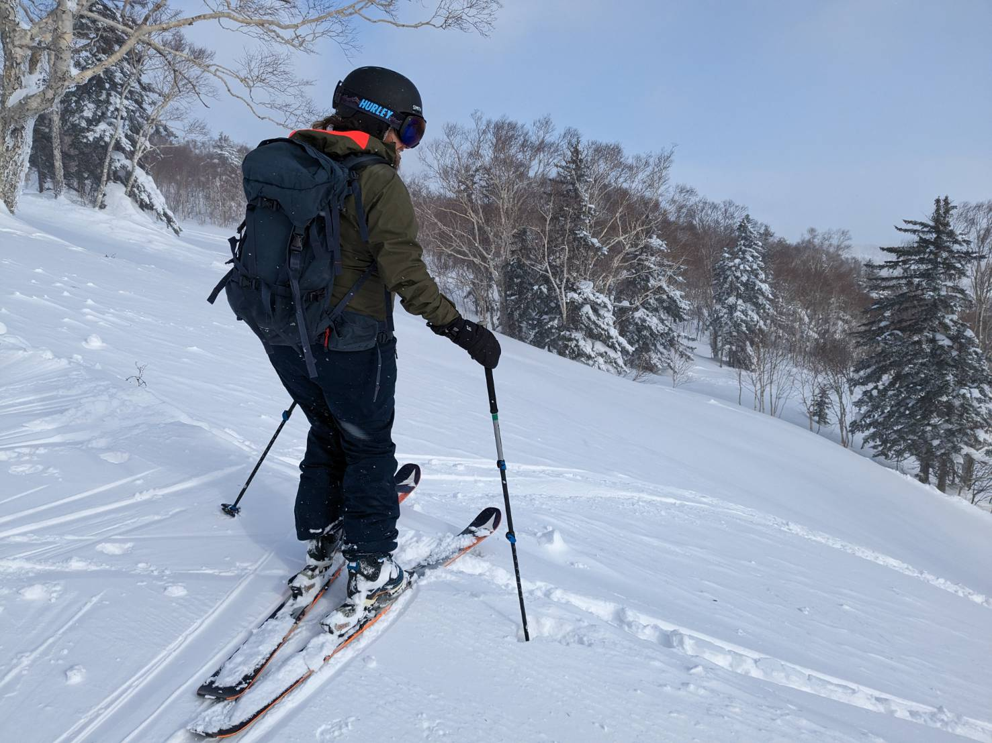
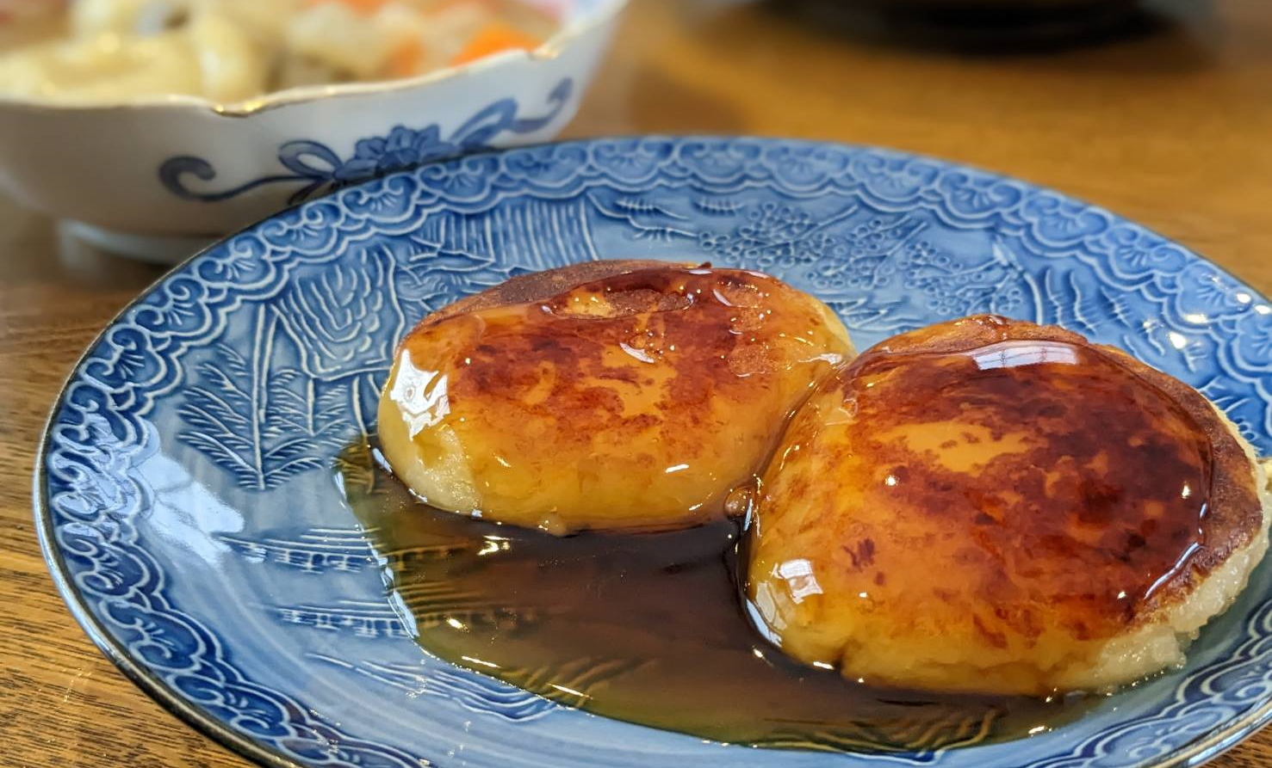
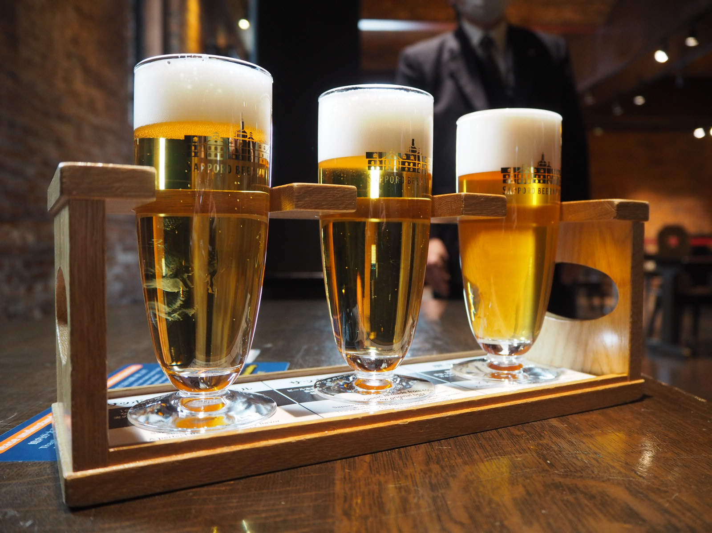
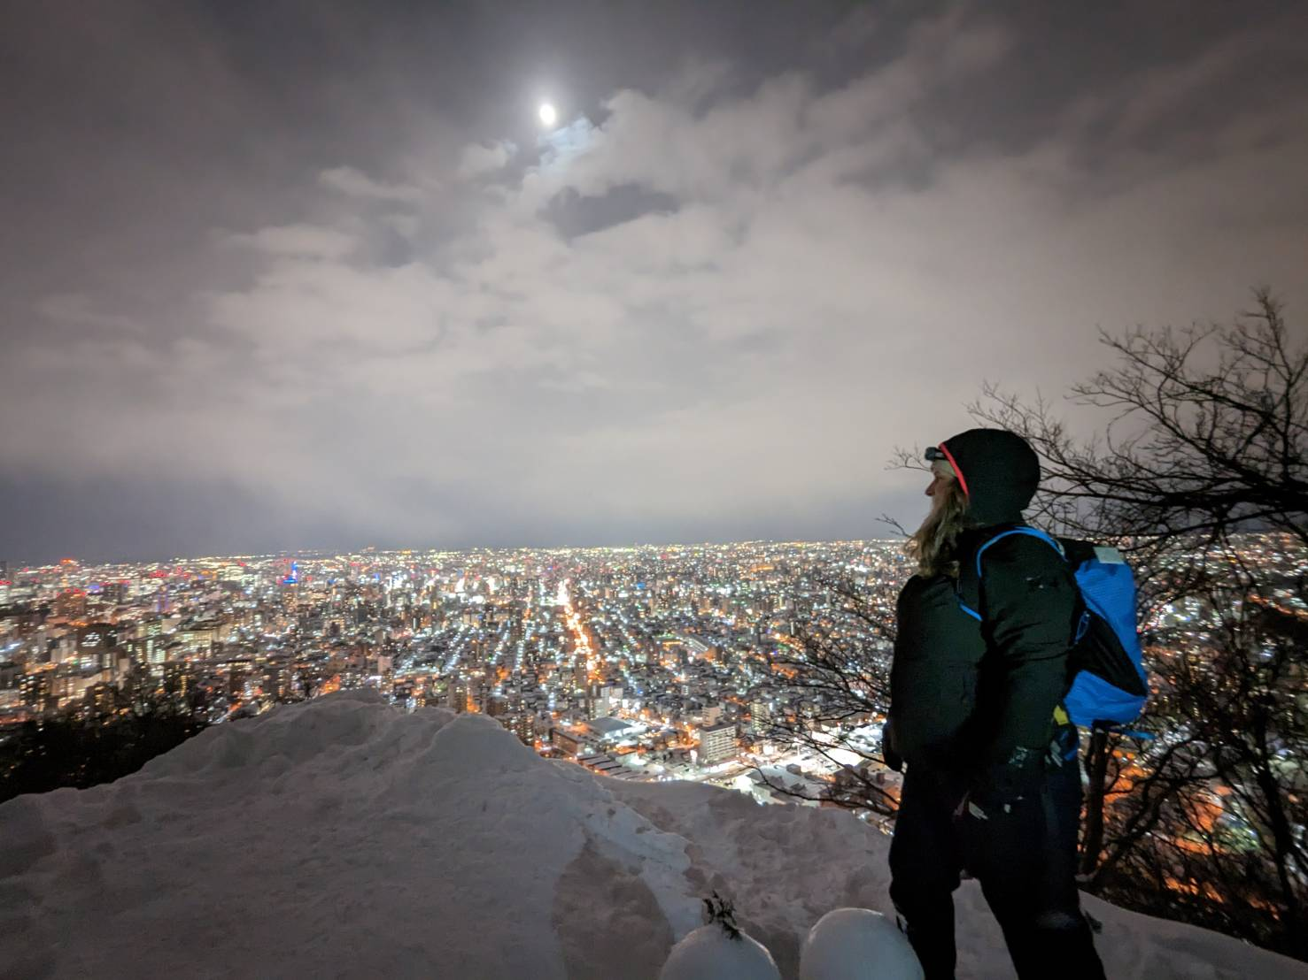
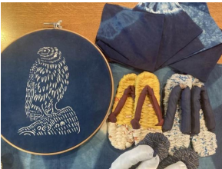
Sapporo Backcountry Tour
Led by a local guide who's a former member of the Japanese Antarctic Research Expedition!
イメージ画像
3～4枚程度（解像度は問わない）
※この場所でなくても、イメージ画像は随時フォームのどの場所でも効果的に挿入してください。
Sapporo is the only large city in the world located in a heavy snowfall area. Urbanization and nature exist side by side and are celebrated in this tour via backcountry skiing and cultural exchanges.
Guided by a local with extensive knowledge of Sapporo and overseas experience – including the Antarctic Research Expedition – enjoy backcountry skiing, night hiking, dinner with locals at a lodge managed by your guide, and more.
A walking tour to experience Sapporo's history, culture and food is also available. Enjoy cross-cultural exchanges!

Slide 2
Sapporo Backcountry Tour
Led by a local guide who's a former member of the Japanese Antarctic Research Expedition!
Highlights:
・Your backcountry ski adventure is led by a native guide who has been to the Antarctic on a research expedition.
・Learn the history and culture of the unique city of Sapporo.
・Cross-cultural exchange to observe the real daily life of Hokkaido people.
・Experience authentic Hokkaido life by visiting and spending time at a private home.
・We highly recommend taking this tour at the start of your Sapporo stay. And, since this is a single-day tour, it's easy to combine it with other Sapporo tour experiences.
・Spend a healthy day, enjoying vegan dishes and doing some light walking (Mariko Ishikawa, your guide, is an expert in intestinal health.)
・Taste traditional snacks made by Hokkaido people.
・Make sustainable cloth sandals to wear during your trip.
Location:
Sapporo, Hokkaido
Main Activity:
Backcountry ski
Difficulty:
4
Availability:
From end of January to head of March
Tour Duration:
3 Nights 4 Days
JPY 403,600 /per（2pax~）
JPY 217,500/per（5pax~）
JPY 172,000円/per（8pax~）
Pax:
Minimum 2
Maximum 10
Price per person:
Route map
Day-by-day Itinerary
What’s included
We provide & What to bring
About us
Information and Requirements
Reservation & Cancellation policy

Slide 3
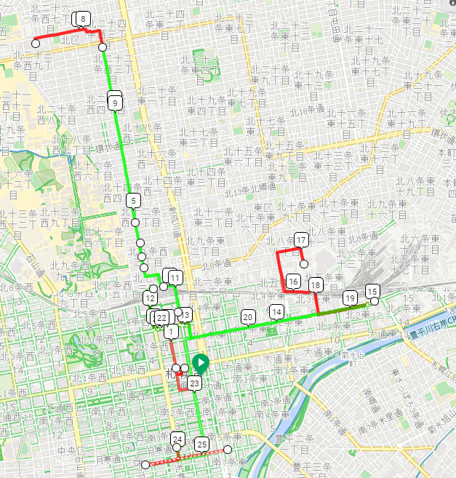
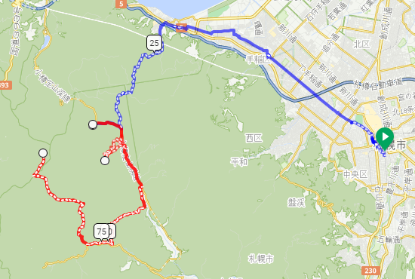
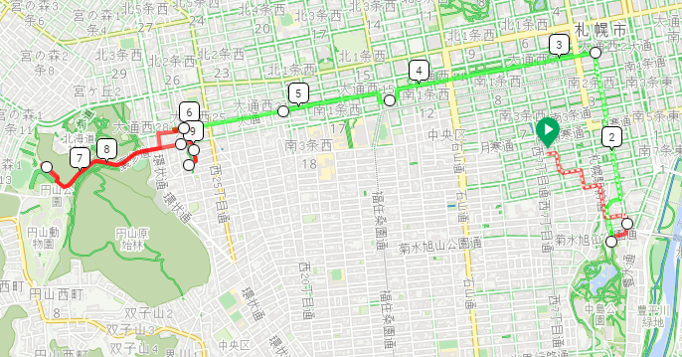
Sapporo Backcountry Tour
Led by a local guide who's a former member of the Japanese Antarctic Research Expedition!
Red: Traveling by train
Light Green: Public Transportation
Blue: Traveling by a private car
Route map <DAY 1~2>
行程を示す地図
添付の例は、Google Mapの「マイマップ」機能利用
＜DAY 1＞
Super Market
& Mariko’s house
Sapporo Beer Hall & museum
Sapporo Sta.
Lunch
Naebo Sta.
Sapporo Clock Tower &
Sapporo City Hall
Sapporo TV Tower
OMO3 Sapporo Susukino(HTL)
Sappolodge
＜DAY 2＞
OMO3 Sapporo Susukino(HTL)
Mt. Asaridake
Sapporo KOKUSAI Ski Resort
Mt. Shiraidake
＜DAY 3＞
Maruyama Park Sta.
OMO3 Sapporo Susukino(HTL)
Hokkaido Shrine
Farm to Table TERRA
Nakajima Sta.

Slide 4
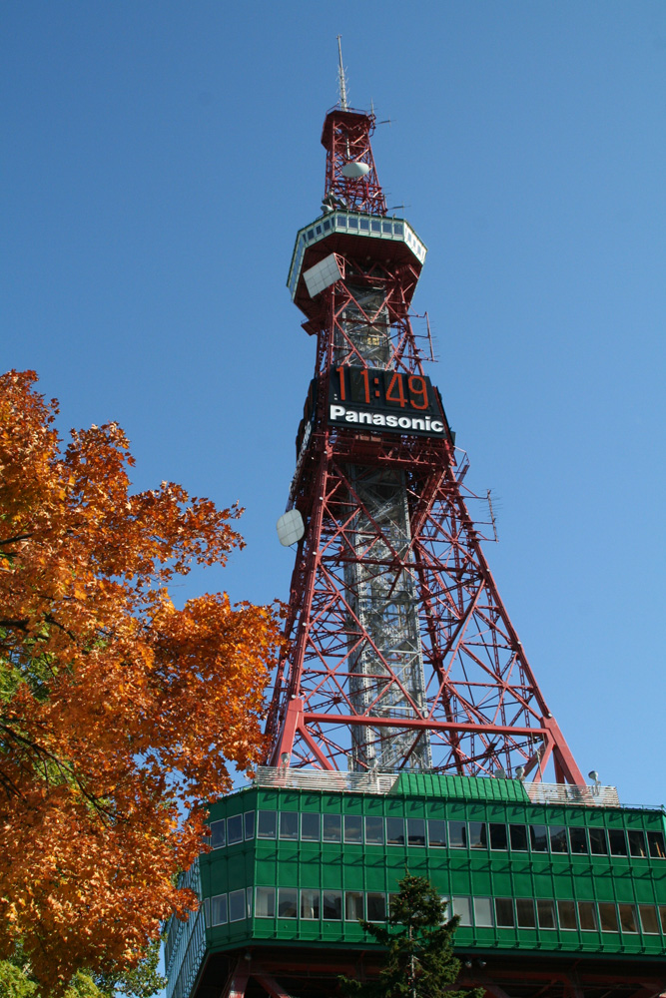
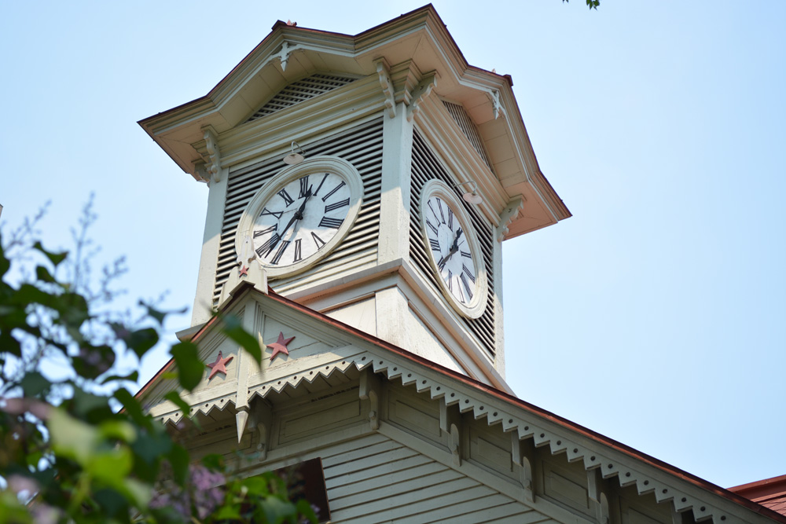
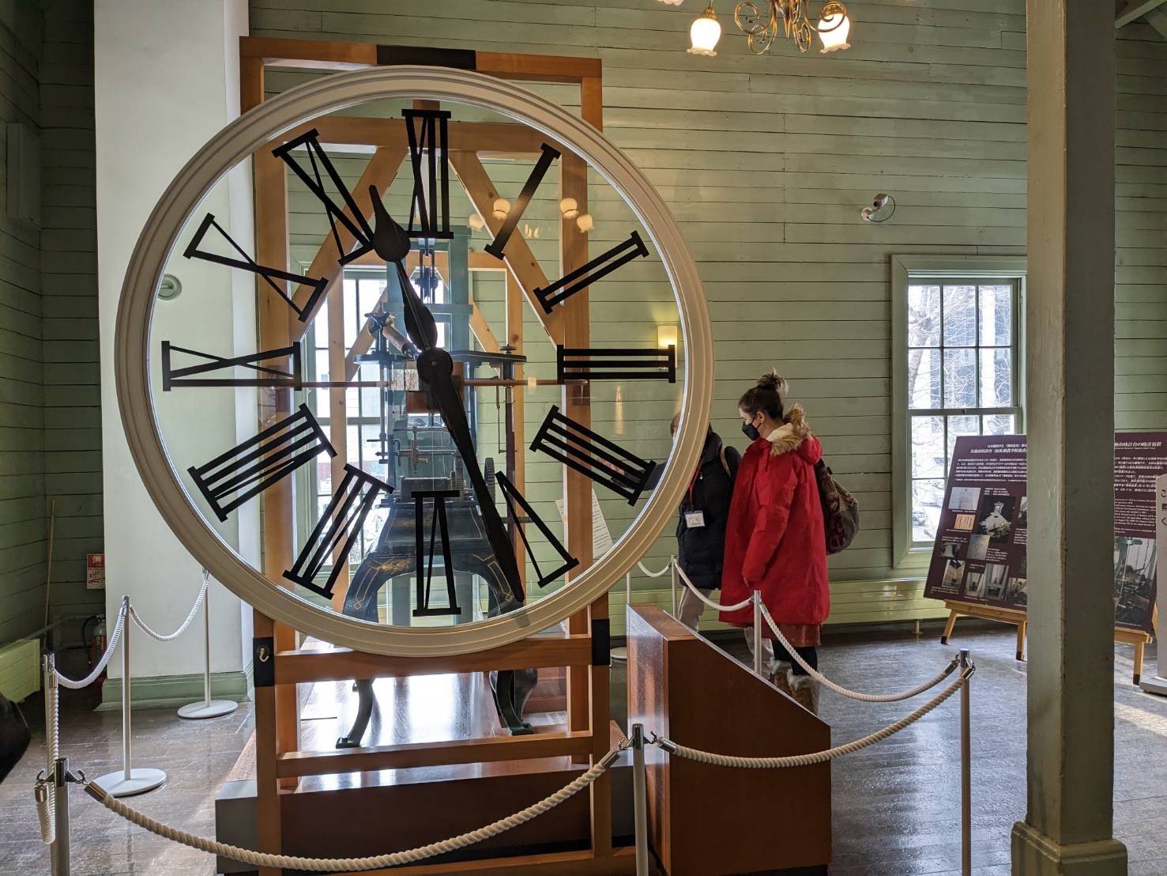
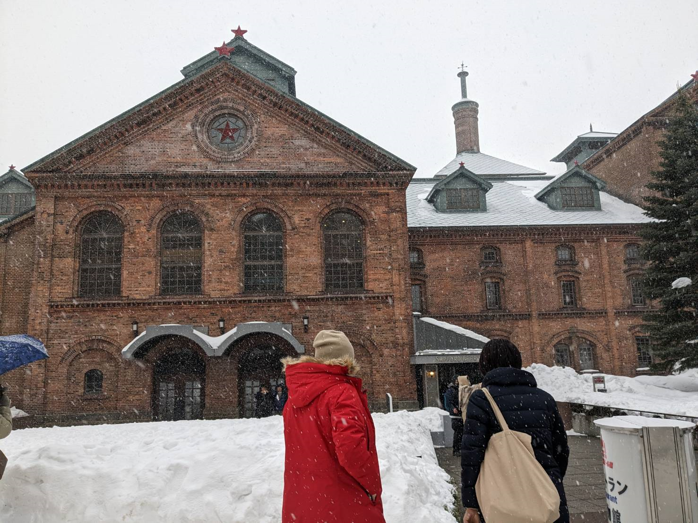
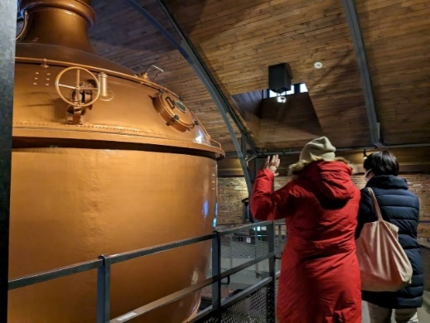
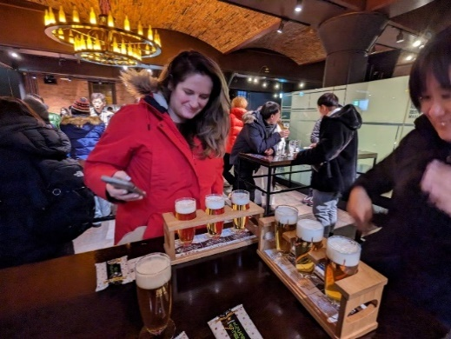
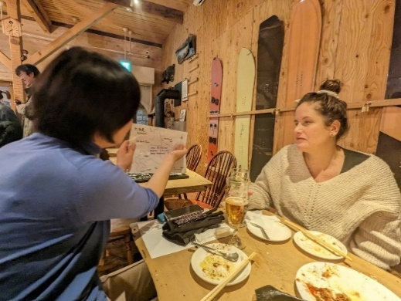
Sapporo Backcountry Tour
Led by a local guide who's a former member of the Japanese Antarctic Research Expedition!
Day-by-day Itinerary
Day 1 – Meet at Sapporo TV Tower
Meet at Sapporo TV Tower at 9:00a.m. to start your Sapporo City tour
Enjoy a 360-degree view of Sapporo's cityscape and learn its history and sightseeing spots you will be visiting
Next, visit Sapporo City Hall and Sapporo Clock Tower to discover the city's pioneer history.
Get to know Shima Yoshitake, the passionate chief magistrate of the Hokkaido Development Commission who authored the original plans to build the city.
Even after Yoshitake-san departed Hokkaido, his plans were followed. Today his ideas, insights, and innovations are seen at every turn of the city.
Lunch
Ramen Sapporo Ichiryuan (vegan dishes available upon request)
Miso paste is a traditional Japanese vegan food. Noodles, soup and toppings are made from non-animal ingredients. Ramen is served with soybean cake.
①Handmade sandals using old kimono cloth, which can be used during your trip.
②Have a tea break with homemade Imo Mochi (potato cake) prepared by the host. Enjoy chatting while doing handwork with cloth, and get local tips and highlights. Feel the authentic local life and start your Hokkaido trip with a friendly, warmhearted feeling.
Sapporo Beer Hall（Sapporo Beer Museum）
Beer brewing is one of Sapporo's major industries. Increase your beer knowledge at the museum, and enjoy tasting the different varieties available at the end of your visit.
Lunch
Dinner
SappoLodge
Dishes featuring Hokkaido local ingredients.
The mountain hat-style building has a bar on the first floor and a guest house on the second.
The lodge is managed by Mr, Nara, who is an activity guide. Various activities and tours can be arranged here.
Hotel:OMO3 Sapporo Susukino
In cooperation with Sapporo Kokusai Ski Resort, the hotel provides a kotatsu (a Japanese foot warmer) made from old gondolas from the resort.
Food and beverages are available for purchase 24/7 at the OMO Base on the first floor.
※Please don‘t forget to buy your Breakfast and Lunch for the following day.
Activity: Walking
Difficulty: 1

Slide 5
Sapporo Backcountry Tour
Led by a local guide who's a former member of the Japanese Antarctic Research Expedition!
Day 2 – Backcountry ski
Breakfast
The hotel provides snacks and refreshments 24 hours a day in the lounge on the first floor, so you can purchase your own breakfast or lunch.
Lunch
●Backcountry ski tour from Sapporo Kokusai Ski Resort.
Mt. Asari：elevation 1,281 m
Mt. Shirai：elevation 1,301 m
Uphill: 2 to 4 hours, depending on weather conditions, fitness, etc.
Downhill: 1 to 2 hour runs
Last downhill run is at 15:00
At the opposite side of the north slope of the ski resort:
①At Kokusai Ski Resort reception, submit a climbing report with the following information: names of all skiers, contact addresses, planned course and schedule, vehicle license plate number(s), etc.
②Enter the backcountry area from the gondola station after checking the beacon.
③Head in the direction of Mt. Asari. Run one powder line. Go uphill and head to the east.
④Head to the hanging ridge. Run from GTR (the upper area of a 1,117 meter peak which forms the second run). Go back uphill.
⑤Head in the direction of Mt. Shirai; your third run is on the south face (for advanced skiers only.)
⑥From Mt. Shirai, glide downhill on the fluffy powder of the north slope, returning to the main ski area. Report your descent at the center lodge to complete your adventure.
Bathe at Hoheikyo Hot Springs (tattoos are OK), then start homeward.
Dinner
Izakaya Yaboten
Serves dishes featuring Hokkaido local ingredients. Vegetarian menu available.
Dinner
Activity: Snowshoeing hike
Difficulty: 4

Slide 6

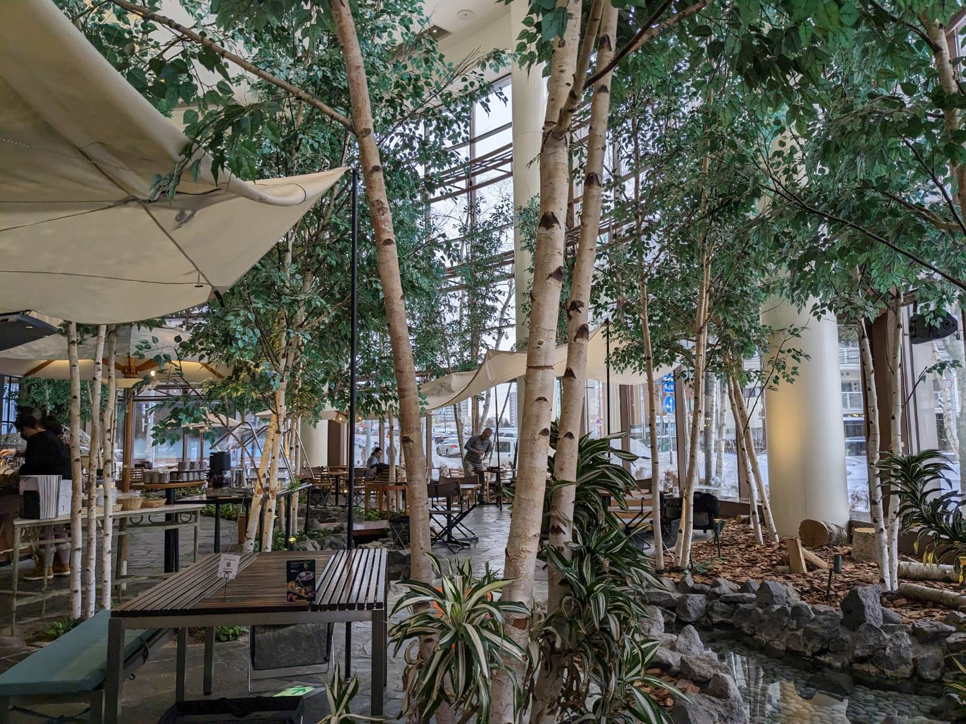
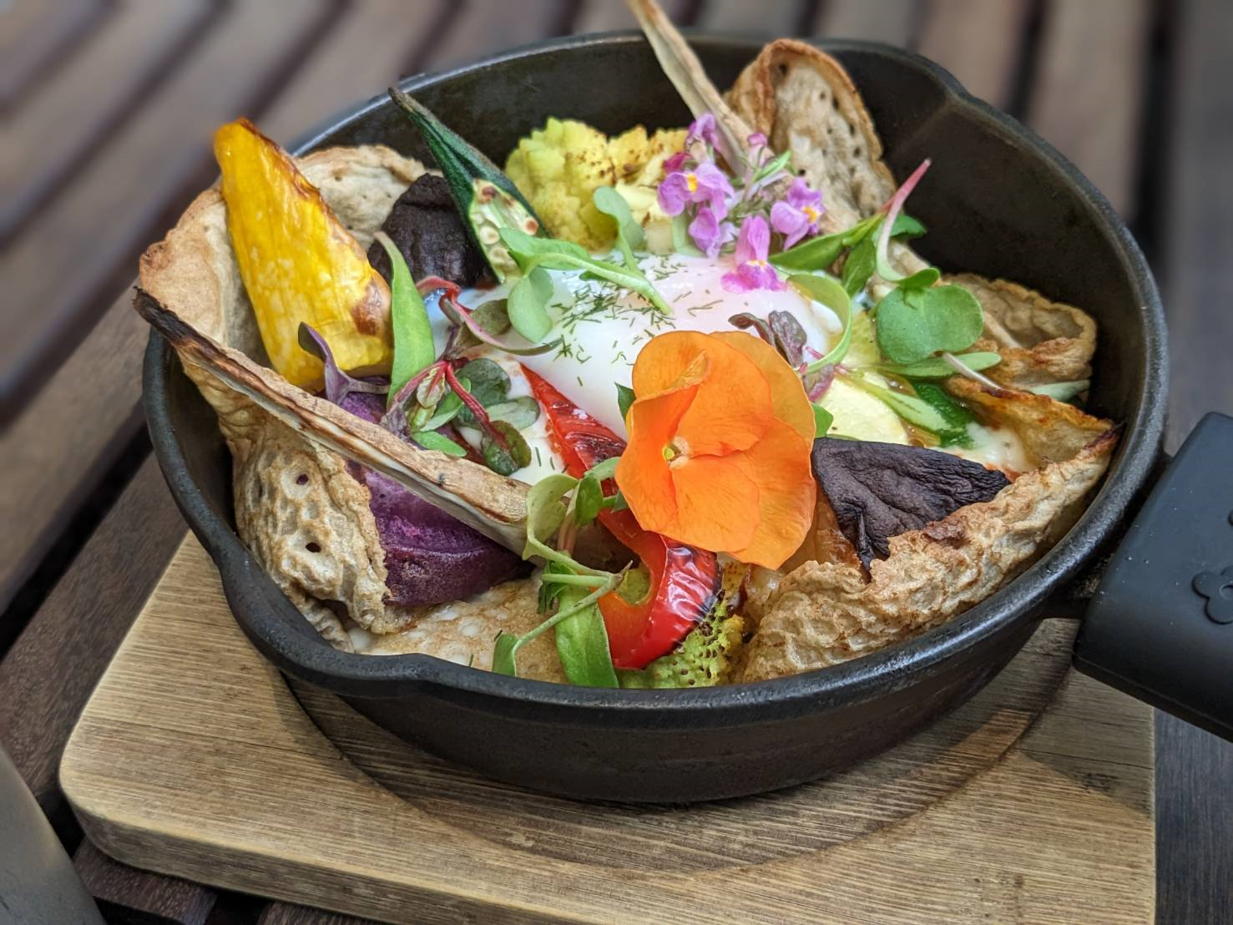
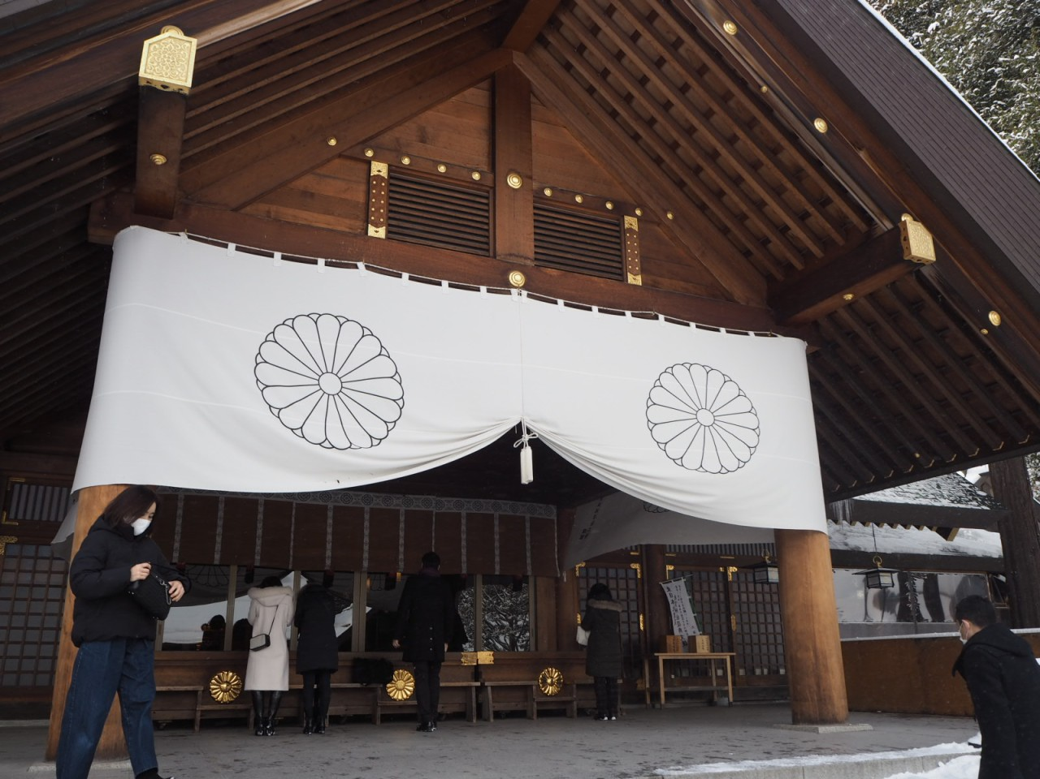
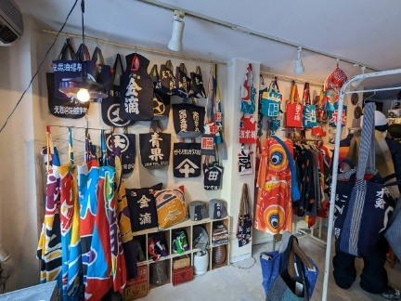
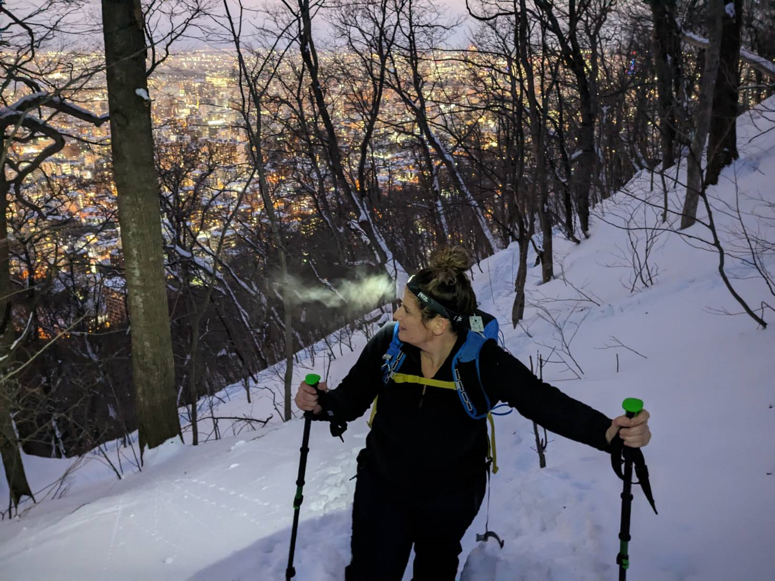
Sapporo Backcountry Tour
Led by a local guide who's a former member of the Japanese Antarctic Research Expedition!
Day 3 – Strolling around around around Maruyama area and night snowshoeing hike
Breakfast
Self
AM Free Time ~ until AM11:30
Lunch
Farm to Table TERRA
Produced by the popular outdoor brand Snow Peak, the interior features an outdoor atmosphere with trees and streams.
Hokkaido Shrine & Strolling around Maruyama area【Time】 2 hours
Take the subway to get to Maruyama Park, and stroll around the Hokkaido Shrine.
Guided by a forest expert, learn about the flora of the park.
Pay respects at the Hokkaido Shrine and learn about Shima Yoshitake, a samurai and Japanese government official who founded the city of Sapporo. Taste the Hangan-sama (a pastry with a sweet bean paste filling) baked here, which are named after Shima himself (his title of Hangan means a chief magistrate of the Meiji Period).
During your leisurely Maruyama stroll, visit a gift shop specializing in items made from colorful fishermen's banners, a rice cracker shop and a cafe for a coffee break.
Mt. Moiwa night snowshoeing hike
【Time】4 hours 【Elevate】531ｍ【Distance】7.0km / ↑552ｍ↓553ｍ
*or Mt. Maruyama (2 hours)
[Total Duration］4 hours, including breaks
Mt. Moiwa：elevation 531ｍ
Distance 7.0km/552ｍ up, 553ｍ down
Enjoy panoramic 360 degree views of Sapporo, and look back over the areas you've discovered on your tour. This is one of the three new great night views of Japan. Reaching mountain summits brings you unforgettable joy!
※If you're too tired to make the descent on foot, you can take the ropeway back.
Dinner
Your local guide will take you bar hopping – visit little-known nightspots hidden among the hustle and bustle of downtown.
Activity: Snowshoeing hike
Difficulty: 3

Slide 7
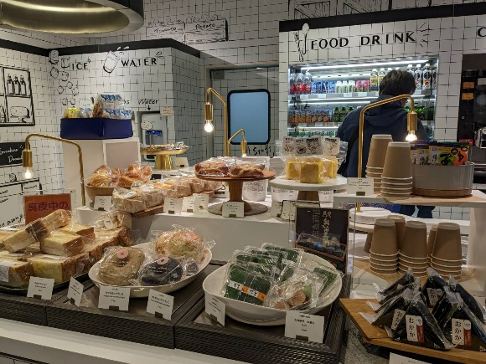
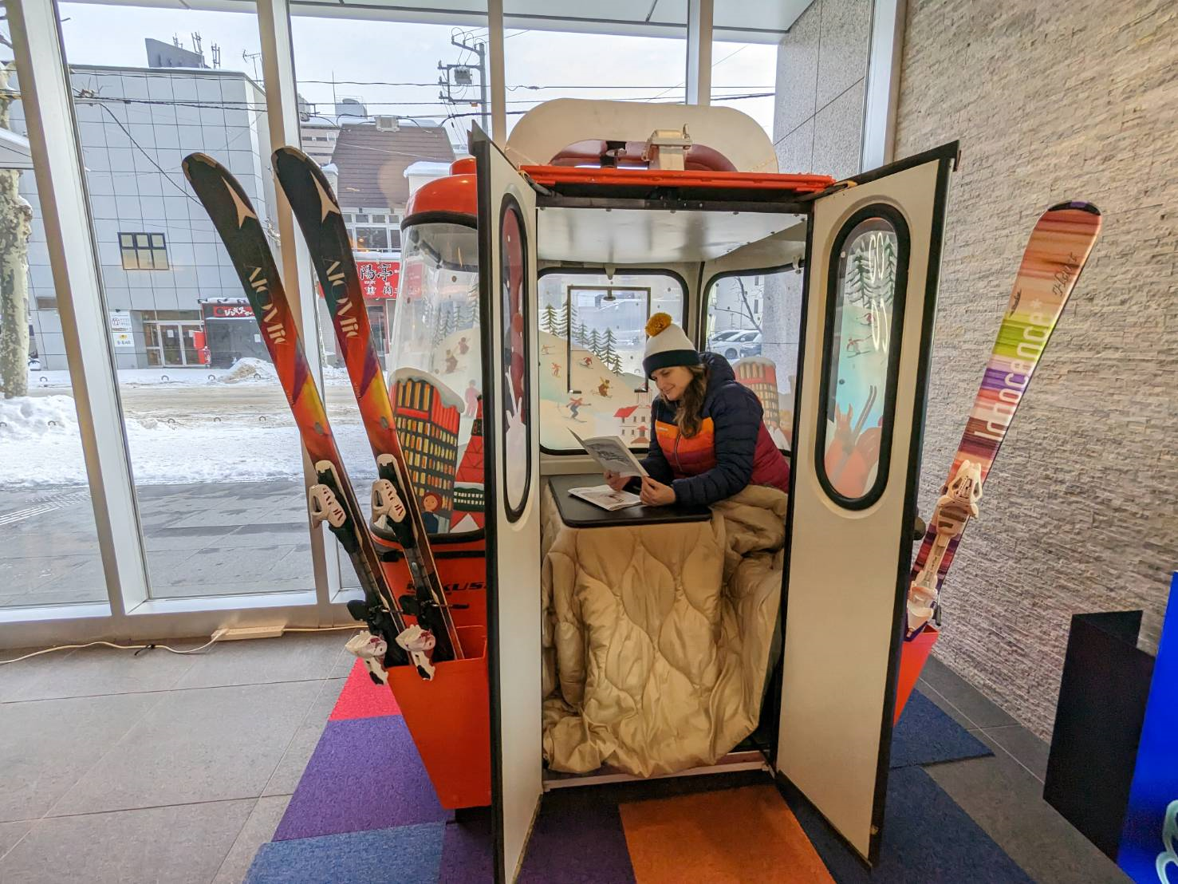
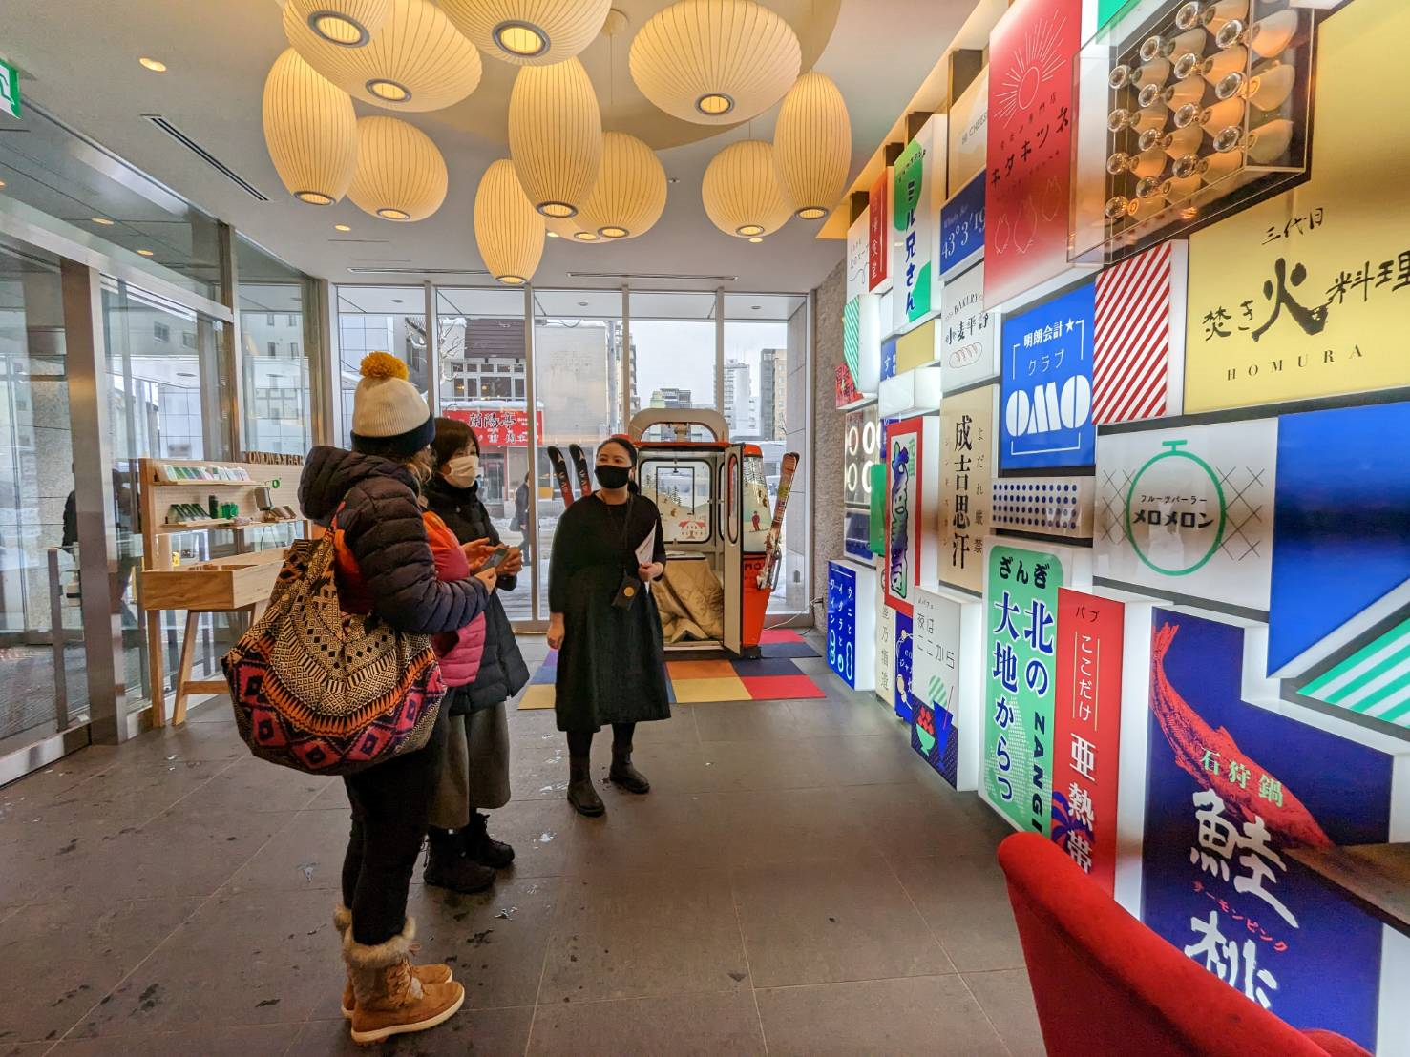
Sapporo Backcountry Tour
Led by a local guide who's a former member of the Japanese Antarctic Research Expedition!
Day 4 – Check out
Breakfast
Self
10:00a.m. check out, end of tour
Accommodations :
Day 1 : OMO3 Sapporo Susukino
Day 2 : OMO3 Sapporo Susukino
Day 3 : OMO3 Sapporo Susukino
In cooperation with Sapporo Kokusai Ski Resort, the hotel provides a kotatsu (a Japanese foot warmer) made from old gondolas from the resort.
What’s included
Activities Fee
Meals
Tour Guide
Private Car

Slide 8
Sapporo Backcountry Tour
Led by a local guide who's a former member of the Japanese Antarctic Research Expedition!
We provide& What to bring
What you must bring
1 | Pasport
2 | Cash | *Since cards are not accepted in some places
3 | warm clothing
4 | changing clothes
5 | Quick-drying innerwear and layered clothing. | *Cotton is prohibited
6 | Sunglasses | *when hiking up
7 | knitted hat
8 | Gloves
9 | Goggles
10 | Helmet
11 | Ski wear(Top and bottom)
12 | Solid shoes (snowshoe mountable)
13 | Down jacket | (compact and put in your backpack and wear over the jacket when it is cold. with hood), down jacket
14 | Water, Thermos water bottle (about 500 ml to 1 liter that can be kept warm)
15 | Chargers for smartphones
16 | Masks
17 | Back pack
Things that are more convenient to have
1 | Handkerchiefs and pocket tissues
2 | "Medicine to prevent sickness.
3 | Sunscreen
4 | spare smart phone battery
5 | first aid kit
6 | Shovels, backpacks
7 | Helmet | Rentals are available, but please bring your own.
8 | Head lamp (new batteries are good OR replacement batteries)
9 | Sunglasses (when hiking up)
10 | hat
11 | Gloves (+ spare)
12 | Goggles (+ spare)
What we provide
Activities | Ski/Snowshoe
 | Telescopic Stock
 | Avalanche Transceiver
 | Probe (sonde stick)
 | Shovels, backpacks
 | Helmet
 | Head lamp (new batteries are good OR replacement batteries)
 | Sunglasses (when hiking up)
 | hat
 | Gloves (+ spare)
 | Goggles (+ spare)
 | Jacket (with hood) & pants (with ventilation)
 | Down jacket
 | Snowshoes & poles
□＝Necessary / △＝Recommended
□Regular warm clothing □Hat・cap
□Gloves
□bathing suit
□Bath Towel
□ Extreme cold weather winter wear (such as ski clothes), warm waterproof winter shoes □ Personal toiletries
□Personal toiletries
□My Bottle, My Cup, My Chopsticks, etc.
△Camera and smart phone
△Disposable heating pads

Slide 9
Sapporo Backcountry Tour
Led by a local guide who's a former member of the Japanese Antarctic Research Expedition!
About us
The company is certified by JATA’s Tour Quality Japan Quality Assurance System for Tour Operators. Our mission is to provide the highest quality services to our clients. We specialize in Japan inbound tours focusing on Hokkaido.
・ATTA Members
・Website for B2B https://www.dmcjapan-knt.com/
Guides
＜Guide for the entire tour: Chie Moue＞
English Instructor, National Government Licensed Guide Interpreter, Forest Instructor, Service Industry English Advisor, Wilderness Advanced First Aid (WAFA), Certified Trainer “Leave No Trace”
Born in 1973 in Fukushima, currently resides in Sapporo. After studies in Forestry and Forest Environmental Education at the Hokkaido Regional Forest Office, learned English teaching methods in Australia. Established “M's English” after working as an English teacher and English Nature Guide in Shiretoko. 16 years of experience as an English instructor, and 14 years as a National Government Licensed Guide Interpreter. Presently conducts various seminars and lectures for the service industry, English guides, and the adventure travel and forest industries.
＜Local Guide: Mariko Ishikawa＞
Born and raised in Sapporo. Cooking instructor specializing in intestinal health (Food Hygiene Manager), Indigo Dye instructor
Self-studied traditional indigo dye processes in her 60's; currently promoting sustainable indigo dye processes in Hokkaido with fellow indigo scholar Etsuko Kameda. Further sustainability activities via the promotion of recycling/reusing old kimono in daily life, including the creation of small articles from kimono and indigo cloth for use in promotional activites.
Has made her own miso paste for more than 30 years. Holds cooking classes at home, using fermented food to enhance intestinal health.
Guides
＜Guide for the entire tour: Chie Moue＞
English Instructor, National Government Licensed Guide Interpreter, Forest Instructor, Service Industry English Advisor, Wilderness Advanced First Aid (WAFA), Certified Trainer “Leave No Trace”
Born in 1973 in Fukushima, currently resides in Sapporo. After studies in Forestry and Forest Environmental Education at the Hokkaido Regional Forest Office, learned English teaching methods in Australia. Established “M's English” after working as an English teacher and English Nature Guide in Shiretoko. 16 years of experience as an English instructor, and 14 years as a National Government Licensed Guide Interpreter. Presently conducts various seminars and lectures for the service industry, English guides, and the adventure travel and forest industries.
＜Local Guide: Mariko Ishikawa＞
Born and raised in Sapporo. Cooking instructor specializing in intestinal health (Food Hygiene Manager), Indigo Dye instructor
Self-studied traditional indigo dye processes in her 60's; currently promoting sustainable indigo dye processes in Hokkaido with fellow indigo scholar Etsuko Kameda. Further sustainability activities via the promotion of recycling/reusing old kimono in daily life, including the creation of small articles from kimono and indigo cloth for use in promotional activites.
Has made her own miso paste for more than 30 years. Holds cooking classes at home, using fermented food to enhance intestinal health.
＜Activity Guide：Wataru Nara＞【Days 2 and 3】
Mr. Nara was a member of the Japanese Antarctic Research Expedition, and has traveled to more than 40 different countries.
Having found a deep fascination in Hokkaido's nature after returning to Japan from his world tours, he opened SappoLodge, a guest house and dining bar also used as the main base for his guide activities.
Mr. Nara enjoys all sorts of outdoor lifestyles, especially winter backcountry skiing and snowboarding in powder snow, and summer kayaking, mountain biking and mountain climbing. He also loves eating local gourmet delights.
｛Qualifications｝
Mountain Guide Stage 1 & Ski Guide Stage 2 certified by the Japan Mountain Guide Association, International Mountain Leader (IML) certified by the Union of International Mountain Leader Associations, Certified General Travel Services Manager
｛Career Record｝
1997: Solo mountaineering at Aconcagua, 2000: Downhill from the summit of Mount McKinley, 2001: Kuril, North Kuril, 2002: Aleutian Islands, 2003: Greenland, 2005: Mt. Elbrus, 2006: West Wall of Mt. Rishiri (mid-winter), 2007: Patagonia (sea kayak & snow boarding), 2011: Member of the 53rd Japanese Antarctic Research Expedition.
＜Activity Support Guide：Yusuke Kunimi＞【Days 2 and 3】
Full-time Employee, Syakotan Outdoor Guide Section (company owned by Mr. Nara)
｛Qualifications｝
Mountain Climbing Guide Stage 2 certified by the Japan Mountain Guide Association
｛Career Record｝
March 2018: Mt. Rishiri, south wall/downhill via Maoyani; north-east wall/downhill via Ochiushinai; and east wall/downhill via Afutoromanai.
April, 2018: Climb Candle Rock, Mt. Rishiri

Slide 10
Sapporo Backcountry Tour
Led by a local guide who's a former member of the Japanese Antarctic Research Expedition!
Guides
＜Activity Guide：Wataru Nara＞【Days 2 and 3】
Mr. Nara was a member of the Japanese Antarctic Research Expedition, and has traveled to more than 40 different countries.
Having found a deep fascination in Hokkaido's nature after returning to Japan from his world tours, he opened SappoLodge, a guest house and dining bar also used as the main base for his guide activities.
Mr. Nara enjoys all sorts of outdoor lifestyles, especially winter backcountry skiing and snowboarding in powder snow, and summer kayaking, mountain biking and mountain climbing. He also loves eating local gourmet delights.
｛Qualifications｝
Mountain Guide Stage 1 & Ski Guide Stage 2 certified by the Japan Mountain Guide Association, International Mountain Leader (IML) certified by the Union of International Mountain Leader Associations, Certified General Travel Services Manager
｛Career Record｝
1997: Solo mountaineering at Aconcagua, 2000: Downhill from the summit of Mount McKinley, 2001: Kuril, North Kuril, 2002: Aleutian Islands, 2003: Greenland, 2005: Mt. Elbrus, 2006: West Wall of Mt. Rishiri (mid-winter), 2007: Patagonia (sea kayak & snow boarding), 2011: Member of the 53rd Japanese Antarctic Research Expedition.
＜Activity Support Guide：Yusuke Kunimi＞【Days 2 and 3】
Full-time Employee, Syakotan Outdoor Guide Section (company owned by Mr. Nara)
｛Qualifications｝
Mountain Climbing Guide Stage 2 certified by the Japan Mountain Guide Association
｛Career Record｝
March 2018: Mt. Rishiri, south wall/downhill via Maoyani; north-east wall/downhill via Ochiushinai; and east wall/downhill via Afutoromanai.
April, 2018: Climb Candle Rock, Mt. Rishiri

Slide 11
Sapporo Backcountry Tour
Led by a local guide who's a former member of the Japanese Antarctic Research Expedition!
Information and Requirements
Dietary Restrictions
We provide special meals for participants with allergies upon advance request.
食事に関する情報、アレルギー、ベジタリアンへの対応など
Emergency Response Plan
・Completed First Aid Training （Basic First Aid Class such as CPR or AED, injury treatment (treat or transport) for broken bones and sprains, treatments for heatstroke, hypothermia, bee stings and allergies including anaphylactic shock, outdoor emergency response training for simulated scenes, such as communication, treatment and transportation)
・Practice sessions at the beginning of each guiding season (summer and winter).
緊急事態への対応など
社の体制、緊急対応計画書の有無、実践経験等を記載
<Operation Flow>
Tour Guide
↓
Tour Leader, Embassies and Consulates in Japan, Insurance Companies, Hospitals, etc.
↓
Accident Management Headquarters, Risk Management Office
↓
CEO, Company President
その他の付加情報があれば記載
例えば、サイクリングや登山であれば、高低差が分かるような、Route PlannerによるElevation図を添付してルートを理解しやすく説明する等もおすすめです。
Reservation & Cancellation Policy
Payment Methods
We will send a booking confirmation by email with an invoice requesting 10% deposit per person due within 2 weeks of invoice date. The remaining balance is due 2
weeks prior to arrival. If KNT Hokkaido has not received deposit amount by the due date,
the booking will be cancelled.
Cancellation
Cancellation Policy / 10% : 1 month Before Departure
20%: 21 Days Before Departure
30% : 15 Days Before Departure
50% : 1 Week Before Departure
80% : Less Than 1 Week

Slide 12
Sapporo Backcountry Tour
Led by a local guide who's a former member of the Japanese Antarctic Research Expedition!
Disclaimer
Disclaimer
We are not liable or responsible for any damages or injuries caused by the following actions and/or reasons:
・Willful or gross negligence caused by insurance policy holders, other insured persons
and insurance beneficiaries
・Fights, suicides and criminal behavior
・Traffic accidents whether or not drivers are insured, the driving of motorcycles without
licenses, driving under the influence of alcohol and/or drugs, whether prescription or
illegal
・Brain and other diseases, insanity
・Pregnancy, childbirth, premature birth, abortion
・Surgical operations (except for accidents caused by us)
・Accidents and riots related to wars and revolutions
・Earthquakes, volcanic eruptions, tsunamis, and other Acts of God
・Nuclear contamination caused by nuclear accidents
・Mountain climbing using tools such as ice axes; rock climbing; luge; bobsled; skeleton
sports; flying planes; sky diving; hang gliding; riding super-light powered machines such
as motor hang gliders, micro light aircraft, and ultra light aircraft.
・Racing, competing, performing and test driving of automobiles, motorcycles,
motorboats, etc.
・Whiplash or back pain without independent medical proof.
・ Willful or gross negligence caused by you.
・ Liability for damages directly caused by your performance of duties (damages occurring during your work)
・ Liability for damages to your consigned goods caused by you (damage to hotel facilities and rooms is however covered)
・ Liability for damages caused by your ownership, usage or management of the following items: vehicles including golf carts and rental cars, motorized bicycles, aircraft, ships including motorboats, and firearms including air guns.
・ Liability for damages to your family members living at the same address as you, and family members traveling together.
・ Liability for damages caused by your loss of mental facilities.
支払方法
支払い方法の一覧を記載（クレジットカード、PayPalなどの電子決済システム、電信送金）
取消条件
免責事項
協力事業者
ツアー催行者・連絡先
Tour Operator / Contact
KNT (Kinki Nippon Tourist Co., Ltd)
h-inbound@or.knt-h.co.jp
NX Sapporo Bldg., 6F, 2-1, West2, North3, Chuo-ku, Sapporo, Hokkaido 060-0003, Japan

