Slide 1
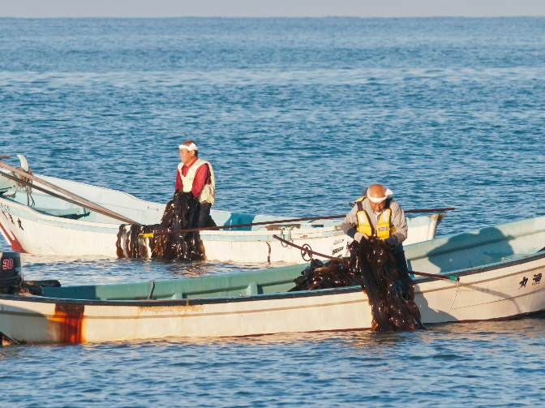
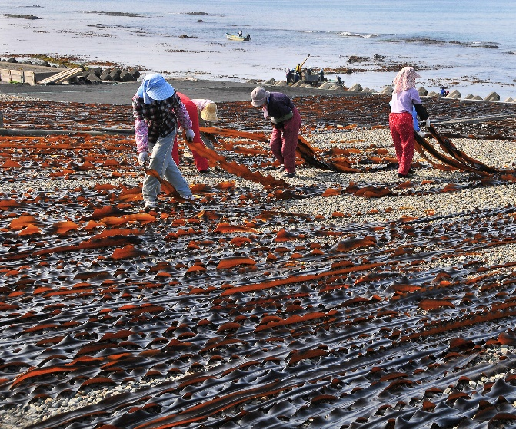
Mitsuishi Kombu Travel – Shinhidaka Cycling Journey
ツアータイトル
シンプルでかつ具体的に書く。最大55文字。メインアクティビティと場所を示すのが理想。
イメージ写真
PSA 4枚程度（解像度は問わない）
Kombu or kelp is an emerging cooking ingredient attracting attention globally. Mitsuishi Kombu, one of the most renowned in the world, is harvested here at Shinhidaka-cho, Hokkaido. Kombu (Kelp) is an ingredient with a strong association with various rituals and seasonal events. It has a long history and association with cultures, and an indispensable part of the people of Shinhidaka-cho in every aspect of their life. This cycling tour highlights the importance of Kombu (kelp), an essential part of Japanese tradition and cuisine, and helps participants feel the significance of the Kombu (kelp) industry that supports the local economy with all of their five senses.
ストーリー
（150語まで。最大2,000文字）
ツアーのストーリー、特別な点は何なのかを伝える。高い次元の話で、宿泊、交通、食事といった旅行の構成要素の話ではない。

Slide 2
Mitsuishi Kombu Travel – Shinhidaka Cycling Journey
ツアータイトル
Highlights:
Hands-on experience of harvesting and processing Kombu (kelp), which has supported the economy of the Hidaka region for many generations
Sampling Kombu(kelp) stock, an essential part of traditional Japanese cuisine
Savoring the taste of Mitsuishi Kombu, which represents Umami, the fifth basic taste after sweetness, sourness, saltiness and bitterness
Enjoying cycling along the coast while admiring the view of sun-drying kelp on the beach, a unique sight that can be seen only at a kelp-producing region
ツアーのハイライト
ハイライト3～5点の箇条書き。
1点につきスペースを含めて80文字以下
ツアーの何が面白いのか参加者が一目で分かるようにする。
Location:
Mitsuishi-Shizunai, Shinhidaka, Hokkaido
実施場所について
ツアーが実施される都道府県、地域を明記する
Main Activity:
Cycling
メインアクティビティ
Difficulty:
3
全体の難易度
Tour Dates:
July, 2023 - September, 2023
ツアー期間
Pax:
Minimum 2
Maximum 4
催行人員
Price:
JPY 120,000
ツアー代金
8名基準、税込み
Route map
各ページへのハイパーリンクを付けています
Day-by-day Itinerary
What’s included
We provide & What to bring
About us
Information and Requirements
Reservation & Cancellation policy

Slide 3
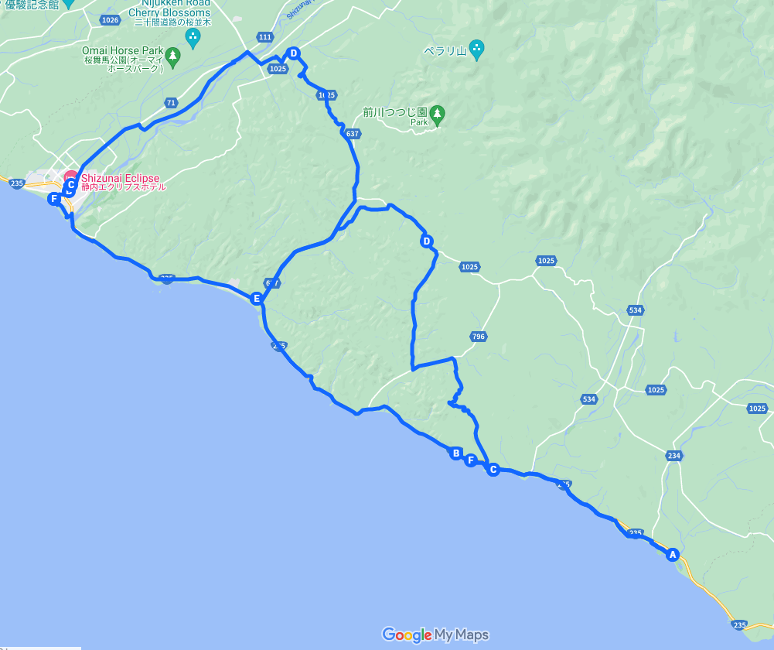
Mitsuishi Kombu Travel – Shinhidaka Cycling Journey
Route map
行程を示す地図
添付の例は、Google Mapの「マイマップ」機能利用
Shinhidaka Tourist Information Centre
Isogai Kaichi Shoten
Mitsuishi Kombu
Porto Mitsuishi
Mitsuishi Konbu Onsen Kurazo

Slide 4
Mitsuishi Kombu Travel – Shinhidaka Cycling Journey
Day-by-day Itinerary
Day 1 - Meet at the site of former JR-Shizunai train station in Shinhidaka-cho to experience Hokkaido’s Umami culture.
実施場所、移動先など
Gather at the Shinhidaka Tourist Information Centre at the site of the former JR-Shizunai train station at 11 am.
Lunch
After a quick briefing, go to the nearby restaurant “Amaya” to experience kelp stock culture while savoring a Japanese lunch using the stock.
１日毎の行程
その日の行程がわかるように文章で記載する。ストーリーとの関連性も記載すると分かりやすい。
After lunch, learn about Kombu (kelp) and its association with Shinhidaka-cho from the curator of a local museum. Start cycling for a first-hand experience of the history and culture of Shinhidaka-cho and Mitsuishi Kombu.
Cycle along the coast to Mitsuishi, where Mitsuishi Kombu is harvested.
On the way, enjoy the view of sun-drying kelp on the beach, a rare sight that can only been seen at a kelp-producing region, and sample the area’s unique dessert, Mitsuishi Kombu Soft-Serve Ice Cream.
Upon arriving at Mitsuishi, receive a briefing on Day 2 schedule at Porto Mitsuishi. Watch a video about kelp harvesting and listen to a lecture to prepare for the next day.
Dinner
Dinner options: Choose from the following options.
① Kaiseki （Japanese cusine）dinner at the hotel: Enjoy Hidaka’s local delicacies including Shinhidaka’s Mitsuishi Beef(Wagyu)and fresh seafoods caught locally.
② Networking dinner with local residents: Interact with local people over dinner to learn about local lifestyles and history.
③ Izakaya plan: Go to a Japanese-style Izakaya tapas pub, recommended by tour guide, and get to know locals who happen to be there on the day.
Soak yourself in a “kelp spa” to finish off Day 1.
食事の場所、内容など
Activity:
Cycling
この日のおもなアクティビティと難易度
アクティビティは、所要時間、距離、地形（トレイル、砂利道、舗装・未舗装など）、（できれば）標高の増減を記載する。複数のアクティビティが1日の中にある場合は、連記する。
Difficulty:
3

Slide 5
Mitsuishi Kombu Travel – Shinhidaka Cycling Journey
Day 2 - Experience Umami, as well as harvesting and sun-drying kelp.
Breakfast
実施場所、移動先など
Japanese style breakfast at the hotel
Leave the hotel at 8 am to head to the kelp harvesting site on the beach you learned about on Day 1.
Help the local kelp farmer, Kaichi Isogai, to go up close and personal with kelp harvesting. Try sun-drying kelp, handed to you by Kaichi-sanupon his return to shore.
１日毎の行程
その日の行程がわかるように文章で記載する。ストーリーとの関連性も記載すると分かりやすい。
Lunch
Savor Japanese family cuisine prepared with Kombu(kelp) stock and dried Kombu(kelp) savings at Porto Mitsuishi. (Rice balls, soup, grilled fish, etc.)
Fill your drink bottle with the original coffee blend by Porto Mitsuishi, before heading back home.
Finish the tour at the Shinhidaka Tourist Information Center at about 4 pm.
食事の場所、内容など
Activity:
Cycling
この日のおもなアクティビティと難易度
アクティビティは、所要時間、距離、地形（トレイル、砂利道、舗装・未舗装など）、（できれば）標高の増減を記載する。複数のアクティビティが1日の中にある場合は、連記する。
Difficulty:
３

Slide 6
Mitsuishi Kombu Travel – Shinhidaka Cycling Journey
Accommodations :
First night: Mitsuishi Konbu Onsen Kurazo at 162 Mitsuishi Kerimai, Shinhidaka-cho, Hidaka-gun, Hokkaido 059-3233.
TEL：0146-34-2300
Room types: Japanese-style room (with a bed) or Western-style room (with toilet but no bath)
宿泊先の情報
宿泊の種別（ホテル、キャンプ、山小屋など）（分かれば名称も入れる）
部屋タイプ、バス・トイレなど
What’s included
Tour guide
Support car
Bicycle rental
Day 1 lunch
Admission to the Shinhidaka Museum
Kelp harvesting / sun-drying experience
Cooking experience
Snacks
Insurance
Bus transport, etc. in case of weather-related cancellation
ツアー代金に含まれるもの

Slide 7
Mitsuishi Kombu Travel – Shinhidaka Cycling Journey
We provide & What to bring
We provide
Bicycle (including E-Bike )
Helmet
Hand sanitizer, non-contact thermometer
Water
Snacks
Support car
ツアーオペレーターが提供するもの
What to bring
参加者にご用意いただくもの
Cycling clothes (minimal skin exposure, easy to move, easy to wash, no flaring trouser hems)
Sneakers
Cold weather clothes
Snacks
Beverage (drink bottle)
Gloves
Sunglasses
Windcheater jacket
Sunscreen
Backpack
Towel

Slide 8
Mitsuishi Kombu Travel – Shinhidaka Cycling Journey
About us
KNT-CT Holdings Co., Ltd.
The company is certified by JATA’s Tour Quality Japan Quality Assurance System for Tour Operators. Our mission is to provide the highest quality services to our clients.
Website(B2B) https://www.dmcjapan-knt.com/
このツアーを主催するオペレーターについての概要
Guides
Cycling guide business: Cycling Frontier
⇒ The business serviced some 2,000 international visitors in FY2019, demonstrating sufficient experiences and skills including first aid.
【Yuya Ishizuka (English language support)】
• Advanced first-aid training (Sapporo City) completed
• JCGA Cycling Guide Master
• JCA Cycling Guide chief examiner
• Cycle Safety Summit (first aide course for response to crash) lecturer
• JCGA (Japan Cycling Guide Association) Cycling Guide Master
• JCGA technical committee member
• JCGA Cycling Guide promotion officer
• Bicycle mechanic
【Tomiyasu Ishikawa (Support car driver)】
• Advanced Fire Management and First Aide course completed
Local guide business: Porto Mitsuishi, Hashimoto Kogyo
Number of local guides: One
【Yasushi Hashimoto (English language support)】
スルーガイド、各アクティビティガイドについて、特徴・資格など
その他注意すべき点があれば記載する

Slide 9
Mitsuishi Kombu Travel – Shinhidaka Cycling Journey
Information and Requirements
Dietary Restrictions
We provide special meals for participants with allergies, and for vegetarians and vegans, upon advance request.
食事に関する情報、アレルギー、ベジタリアンへの対応など
Emergency Response Plan
・An expert from the tour operating company will escort the group throughout the entire tour.
・Shinhidaka-cho officials will stand by to provide extra support as needed.
・A complete emergency medical kit (adhesive tapes, bandages, disinfectant, etc.) will be
carried in each supporting vehicle.
・Emergency response manuals will also be carried.
・Cycling Frontier Hokkaido's own emergency response procedures will also be incorporated.
【In case of Inclement Weather】
・Cycling tours will be canceled upon the issuance of high wind warnings, evacuation advisories, and lightning warnings.
【Substitute Plan】
In case the cycling tour is canceled, participants will switch over to a bus tour as follows:
・Itinerary
① Amaya: Experiencing Umami culture – Japanese-style lunch
② Shinhidaka Museum: History of kelp lecture by the curator
③ Mitsuishi Kombu: Enjoying kelp soft-serve ice cream
④ Porto Mitsuishi: Briefing for Day 2
⑤ Mitsuishi Konbu Onsen Kurazo: Dinner and accommodation
⑥ Isogai Kaichi Shoten: Experiencing kelp processing
⑦ Porto Mitsuishi: Experiencing Japanese family meal (rice balls, soup, grilled fish)
緊急事態への対応など
社の体制、緊急対応計画書の有無、実践経験等を記載

Slide 10
Mitsuishi Kombu Travel – Shinhidaka Cycling Journey
Disclaimer
Disclaimer
免責事項
We are not liable or responsible for any damages or injuries caused by the following actions and/or reasons:
・Willful or gross negligence caused by insurance policy holders, other insured persons
and insurance beneficiaries
・Fights, suicides and criminal behavior
・Traffic accidents whether or not drivers are insured, the driving of motorcycles without
licenses, driving under the influence of alcohol and/or drugs, whether prescription or
illegal
・Brain and other diseases, insanity
・Pregnancy, childbirth, premature birth, abortion
・Surgical operations (except for accidents caused by us)
・Accidents and riots related to wars and revolutions
・Earthquakes, volcanic eruptions, tsunamis, and other Acts of God
・Nuclear contamination caused by nuclear accidents
・Mountain climbing using tools such as ice axes; rock climbing; luge; bobsled; skeleton
sports; flying planes; sky diving; hang gliding; riding super-light powered machines such
as motor hang gliders, micro light aircraft, and ultra light aircraft.
・Racing, competing, performing and test driving of automobiles, motorcycles,
motorboats, etc.
・Whiplash or back pain without independent medical proof.
Partner Company
CYCLING FRONTIER HOKKAIDO
Shinhidaka-cho Town Office
Porto Mitsuishi
協力事業者
Tour Operator / Contact
ツアー催行者・連絡先
KNT-CT Holdings Co., Ltd.
2-6-1 Nishi-Shinjuku, Shinjuku-ku, Tokyo
y.miura662@kntct.com

